Slide 1
Portrait Narrative Series
Troutman

Slide 2
Your goal for this assignment is to select a person and create a series of photos of them doing what they love. What is their craft? writing, basketball, playing an instrument, cooking, painting, working on a car...
Tell the story of this person through a series of 6 photographs of them in their working or favorite environment.

Slide 3
You will upload 6 photos:
Wide angle shot of the setting or environment
Close up traditional portrait
Candid portrait as they talk or work
Detail shot of their tools or workspace
Shot of what they're making or in action
Final closing shot to wrap up the story

Slide 4
Grant Scott
Series of photos of London pop artist
Allen Jones

Slide 5
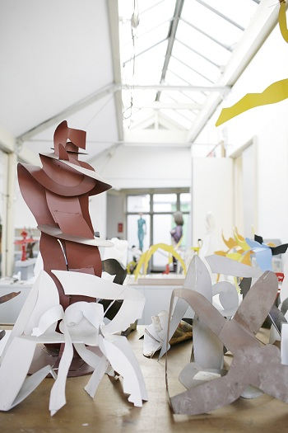
Wide angle shot of the setting or environment

Slide 6
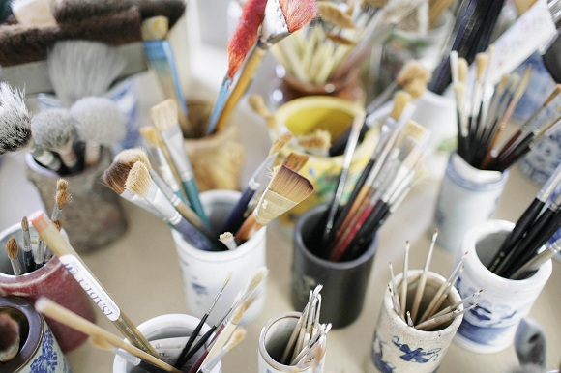
Detail shot of their tools or workspace

Slide 7
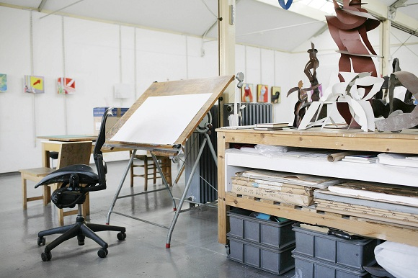
Wide angle shot of the setting or environment

Slide 8
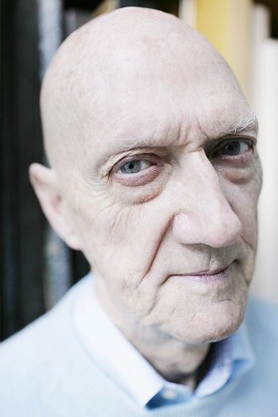
Close up traditional portrait

Slide 9
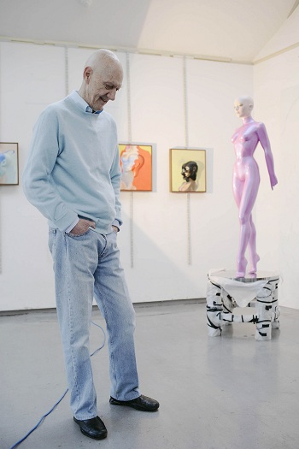
Candid portrait as they talk or work

Slide 10
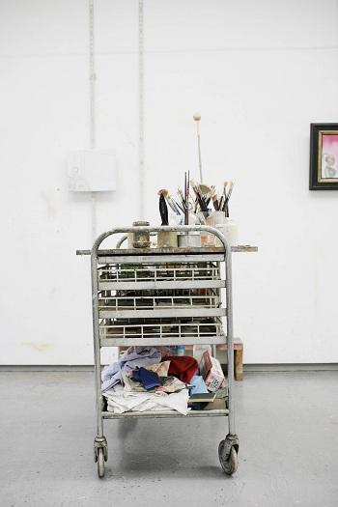
Final closing shot to wrap up the story

Slide 11
Benjamin Heath
Commissioned photoseries for Hyundai USA

Slide 12
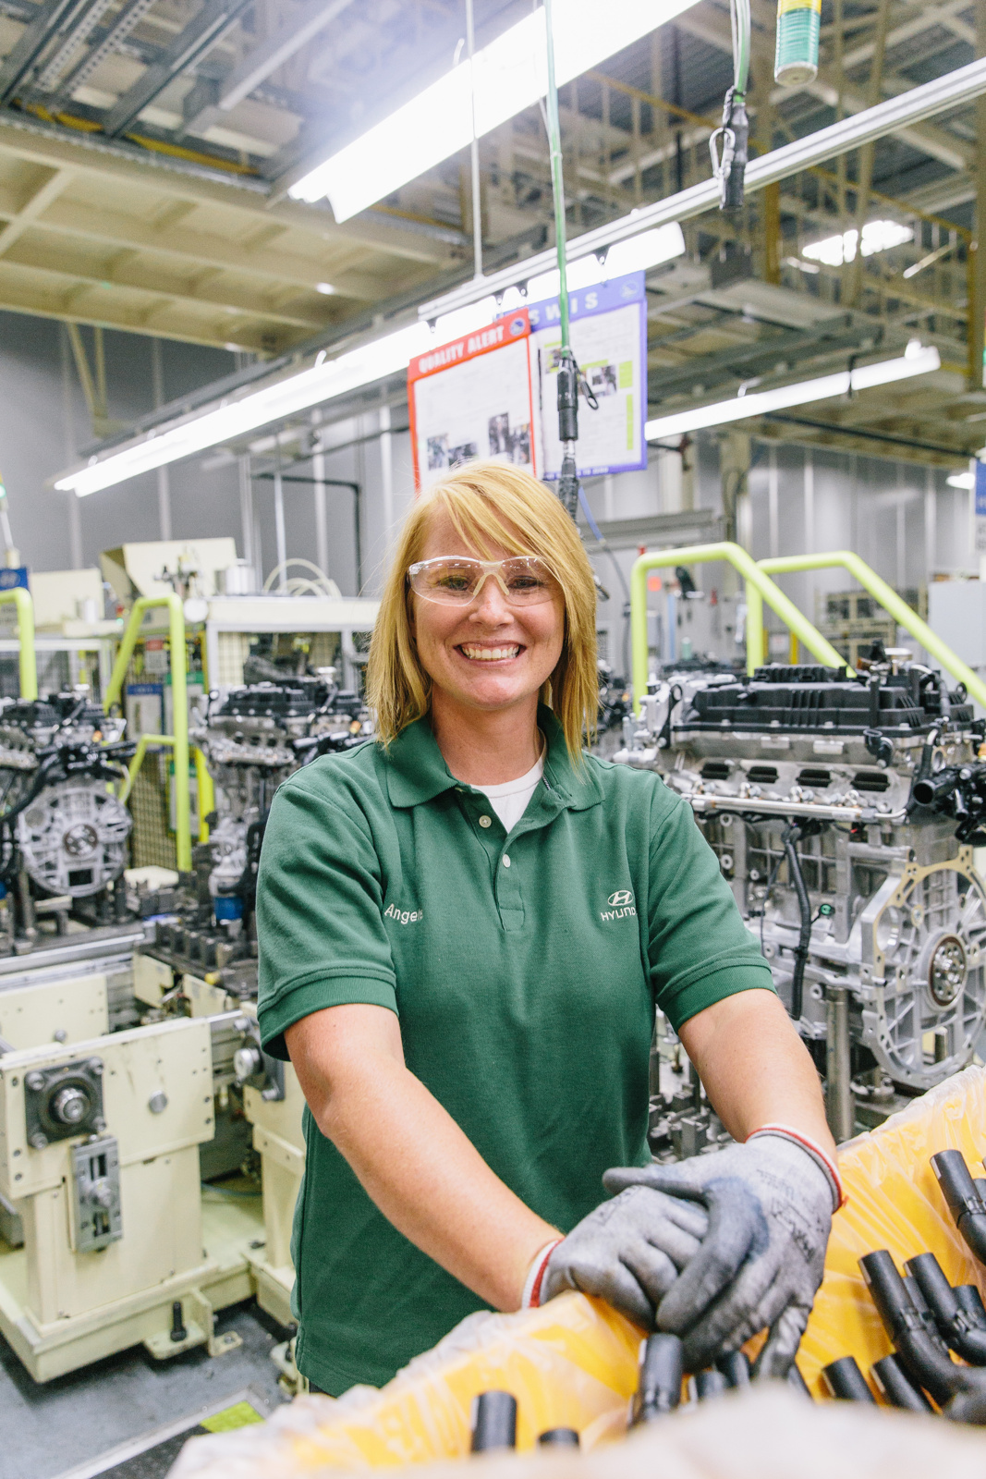

Slide 13
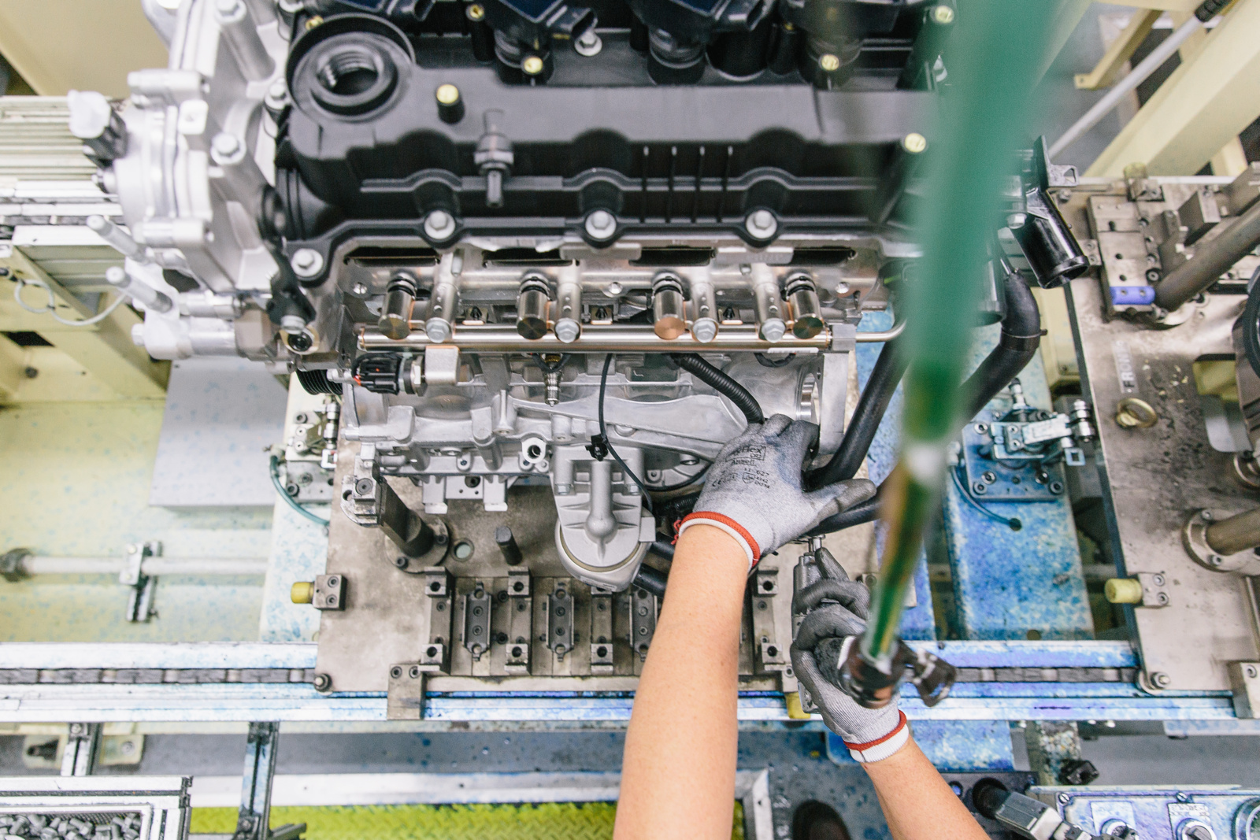
Shot of what they're making or in action

Slide 14
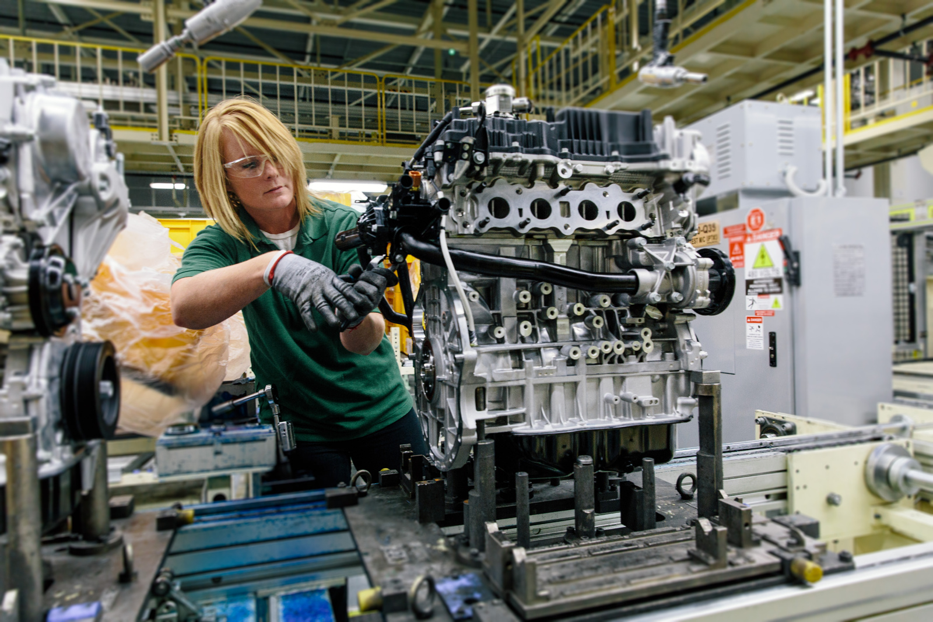
Shot of what they're making or in action/ Candid portrait as they talk or work

Slide 15
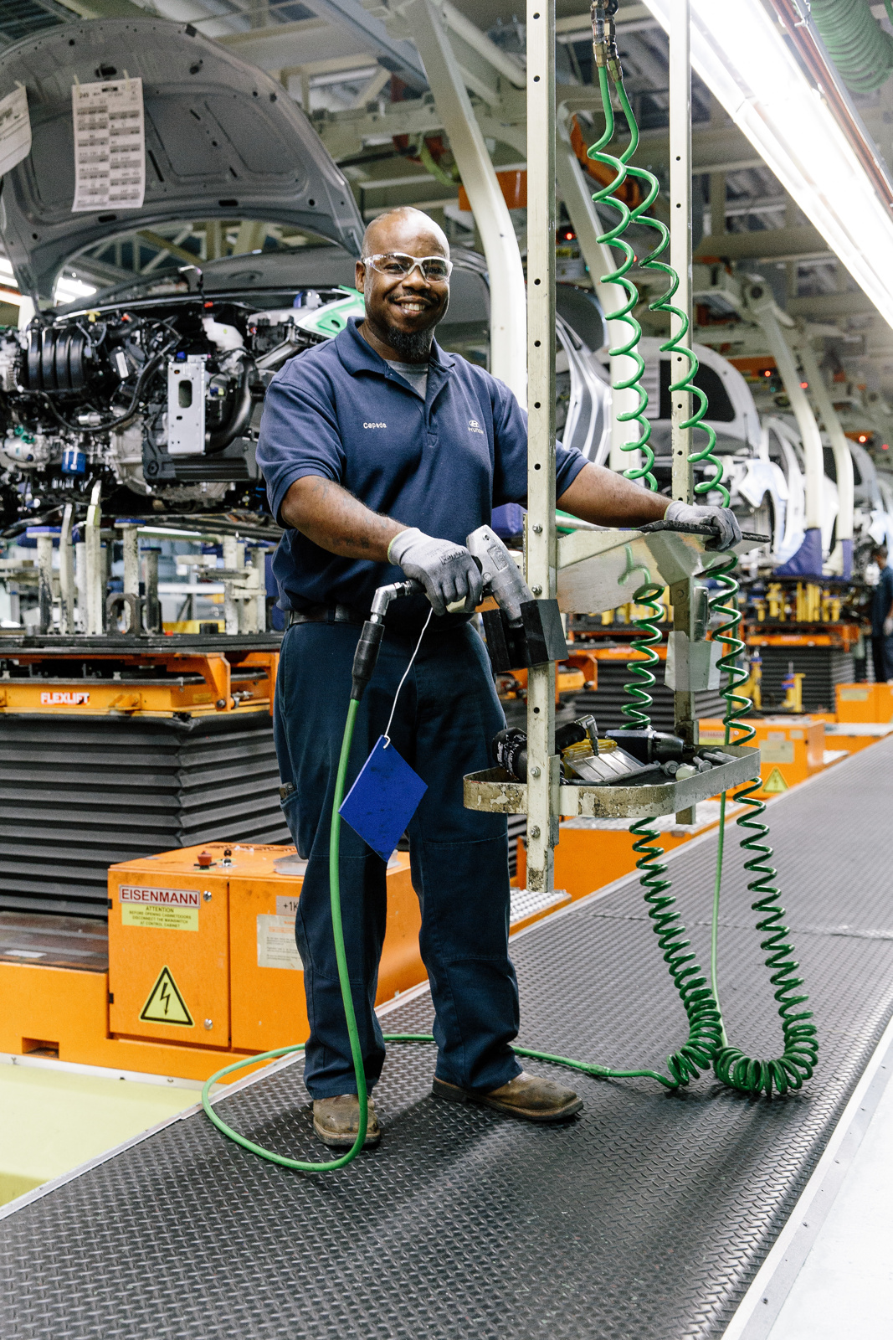

Slide 16
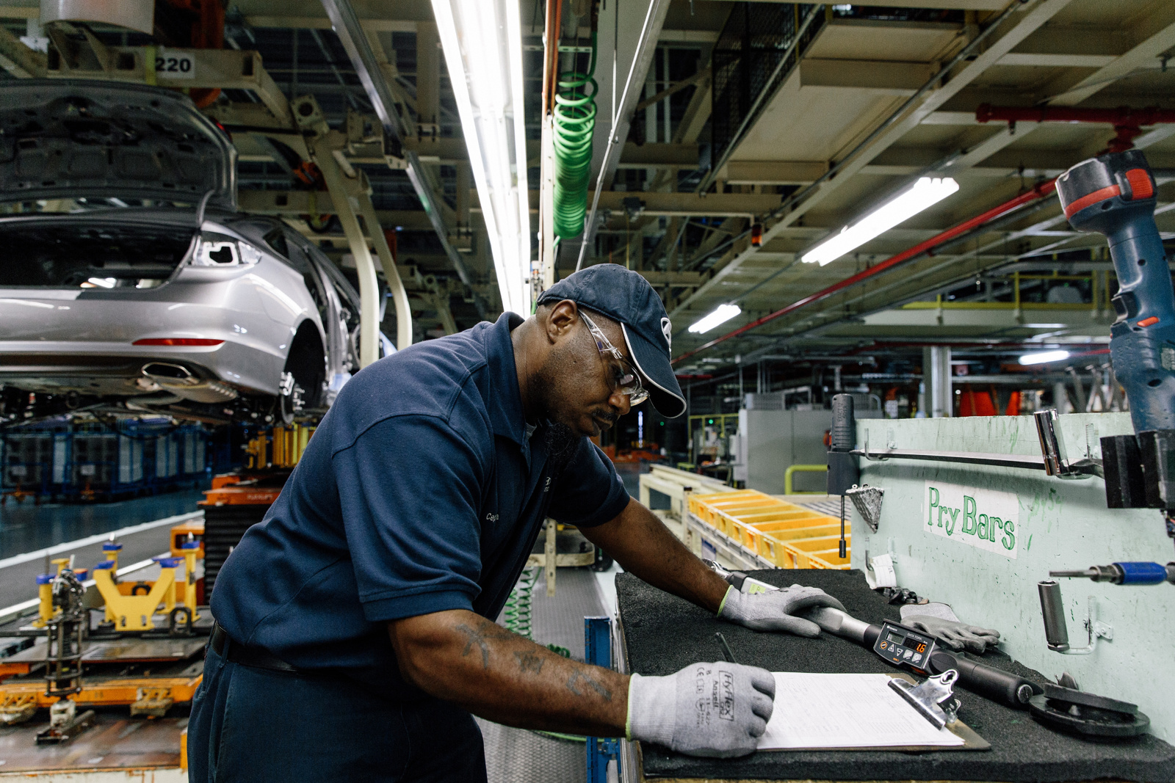

Slide 17
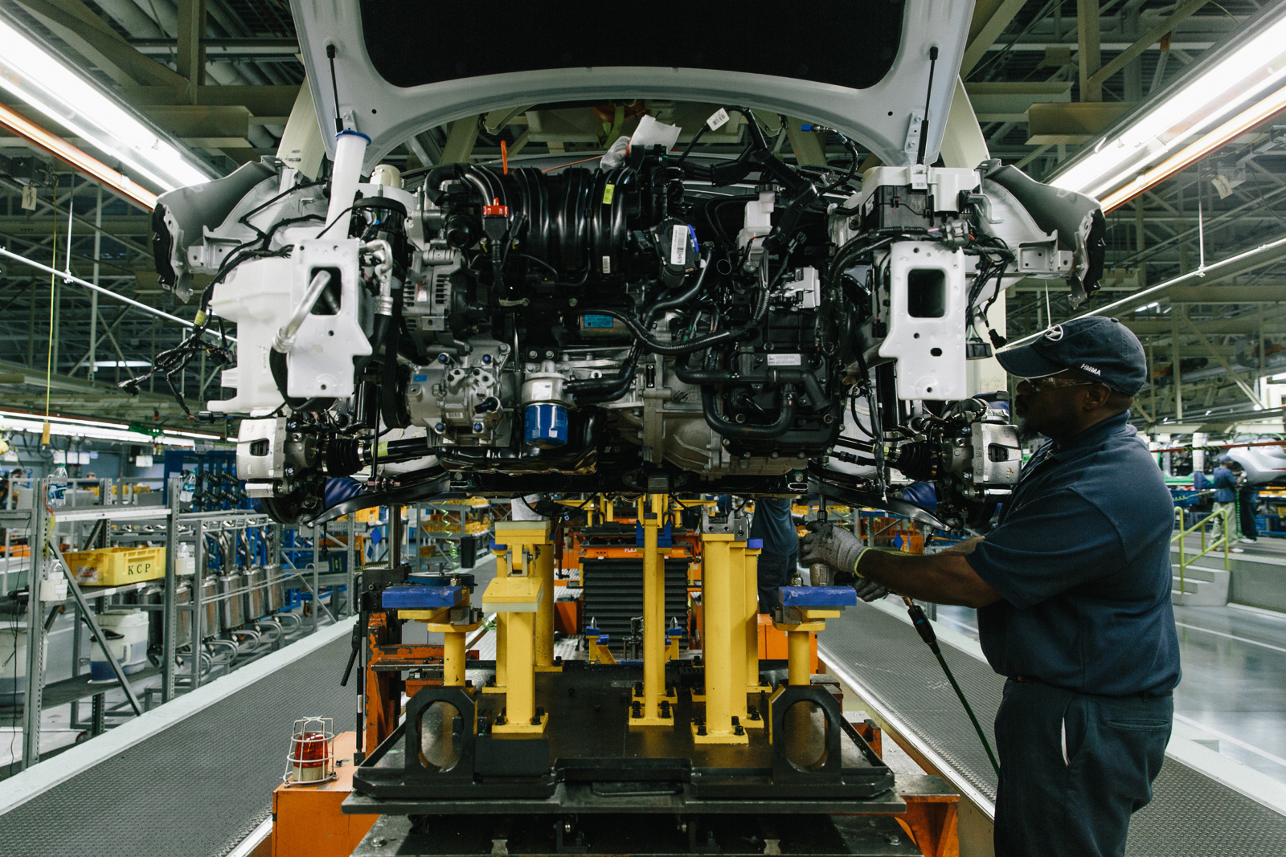

Slide 18
Maria Jose Sesma
portraits of women in Mexico

Slide 19
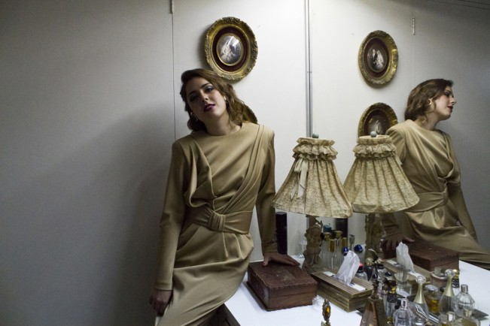

Slide 20
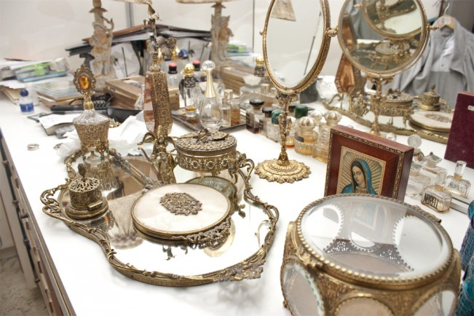

Slide 21
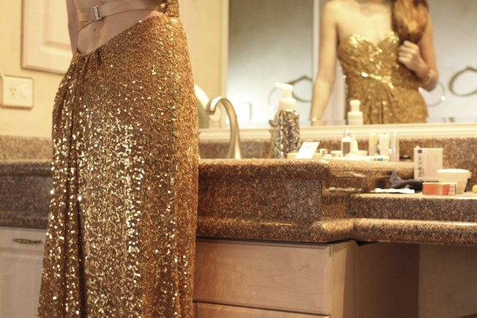

Slide 22
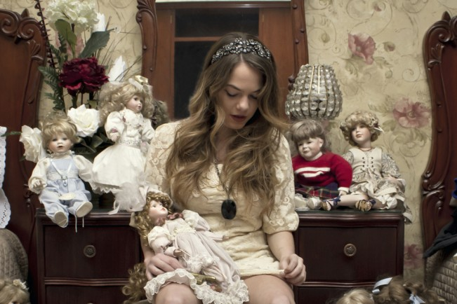

Slide 23
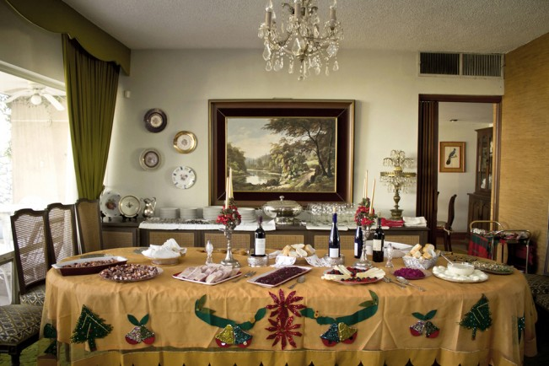

Slide 24
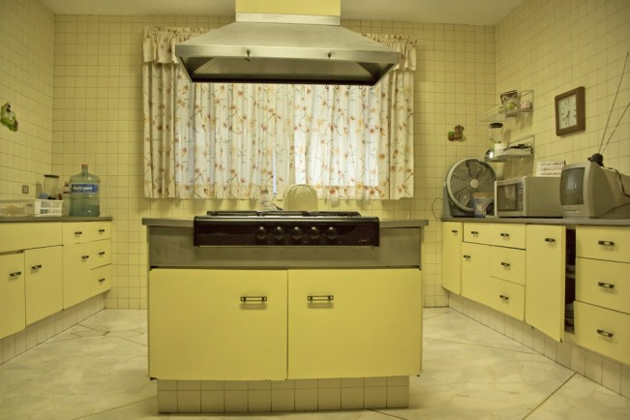

Slide 25
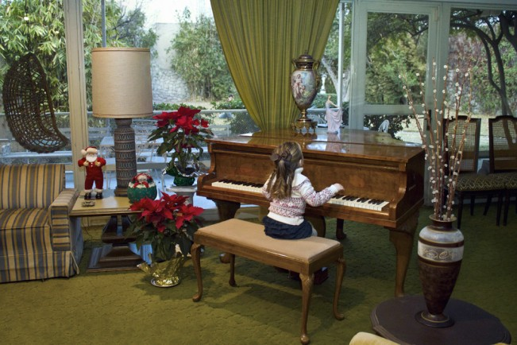

Slide 26
Consider:
How can you make your subject feel comfortable and relaxed during the shoot?
What story can you tell about this person?
Where will the photos be shot?
How can you create a compelling series of photos about this person?

Slide 27
Consider:
Think about your composition, (distance, point of view) lighting, and location.
How will setting and action communicate more information about your subject?

Slide 28
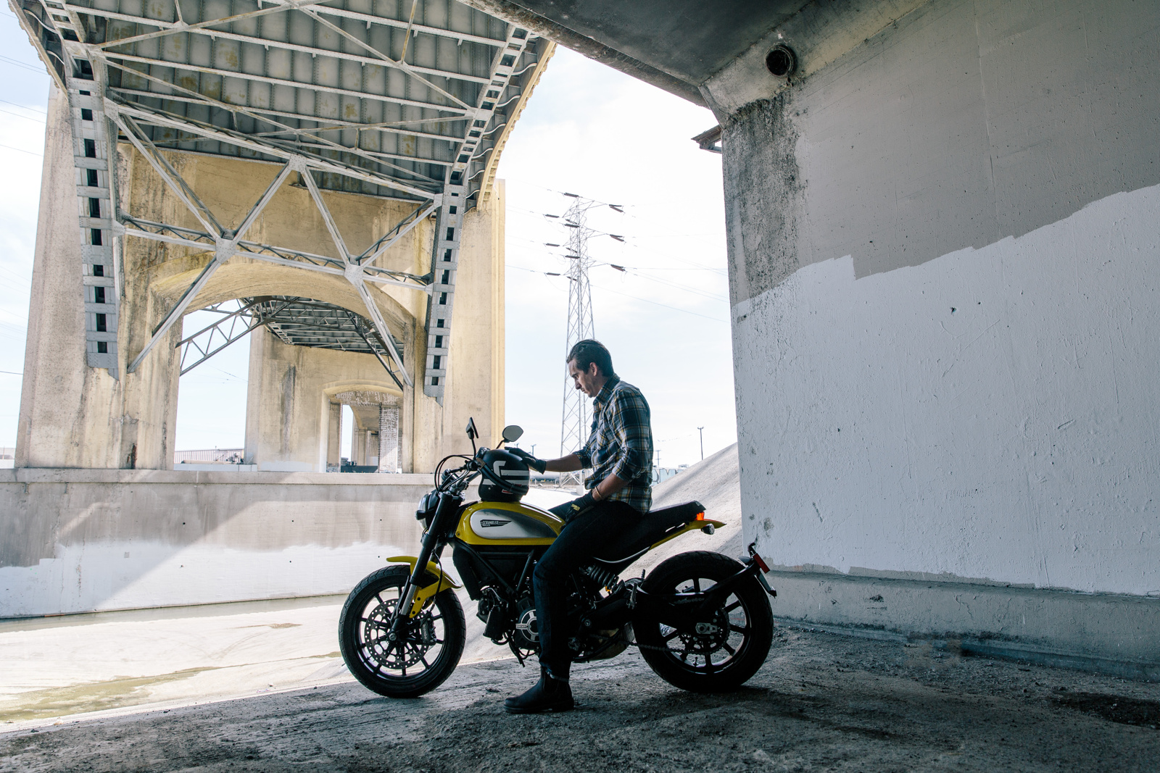

Slide 29
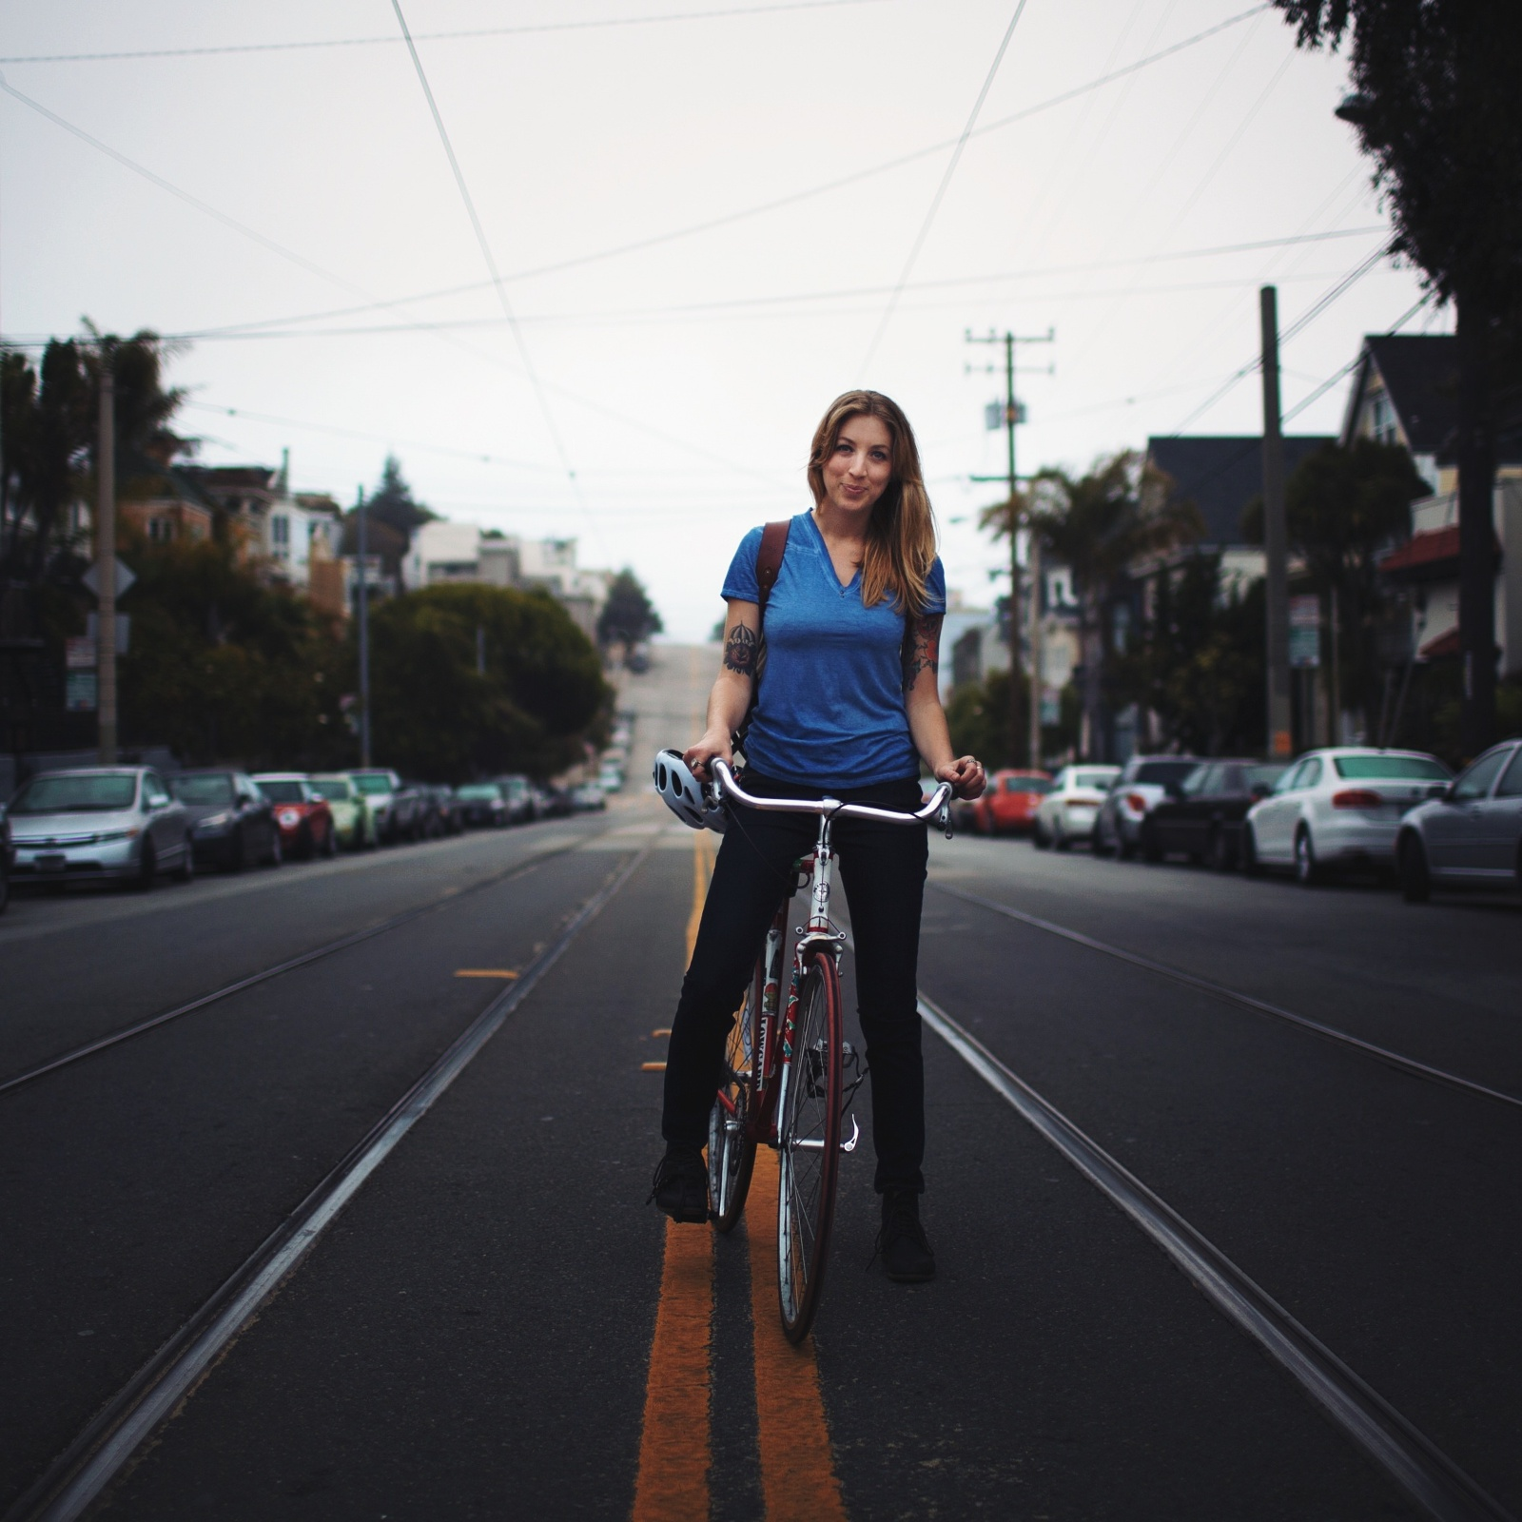

Slide 30
